Slide 1
LEADERSHIP INSIGHTS
Todd
Gibson
October
2020

Slide 2
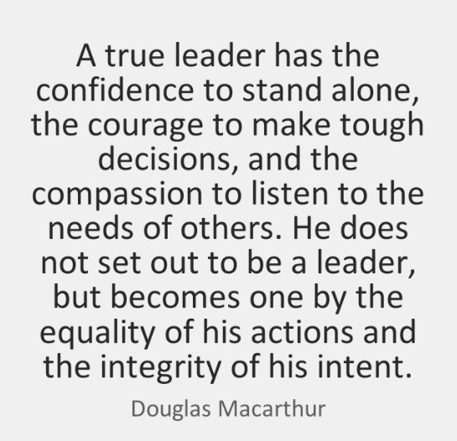
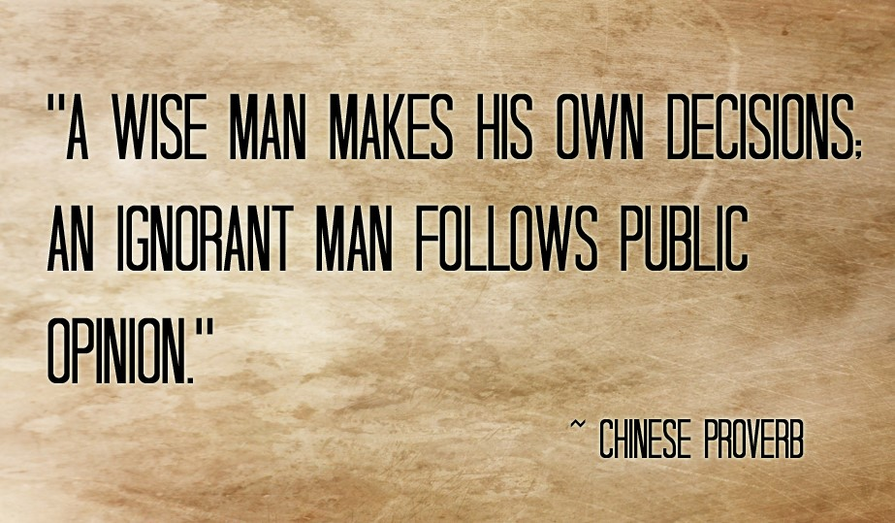

Slide 4
POLICING PAST

Slide 5
POLICING PAST

Slide 6
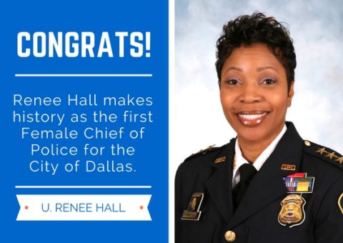
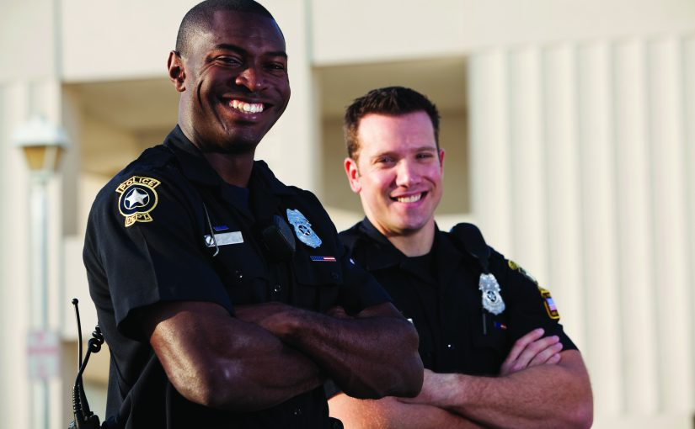
POLICING PRESENT

Slide 7
Policing Present
What do we ask of police officers everyday in modern day policing?

Slide 8
Policing Present
Policing by the numbers
330 million Americans
750,000 Police Officers
240 million Calls for 911 each Year
53 million Police Calls for Service each Year
1.21 million Violent Crimes a Year (2018)

Slide 9
Policing Present
Policing by the numbers
According to the Washington Post over the last 5 years police shoot and kill and average of 1000 people per year.
Approximately 88 percent of those killed have been armed with guns, knives, or some type of weapon and 4 percent unarmed.

Slide 10
Policing Present
Policing by the numbers
On average 40 unarmed people a year.
Under physical attack in about 40% percent of the cases. The remaining 60% percent involved a variety of other circumstances.
1000 people shot extrapolated out over 53 million calls for service is 0.0000187 percent chance of being shot and killed by police.

Slide 11
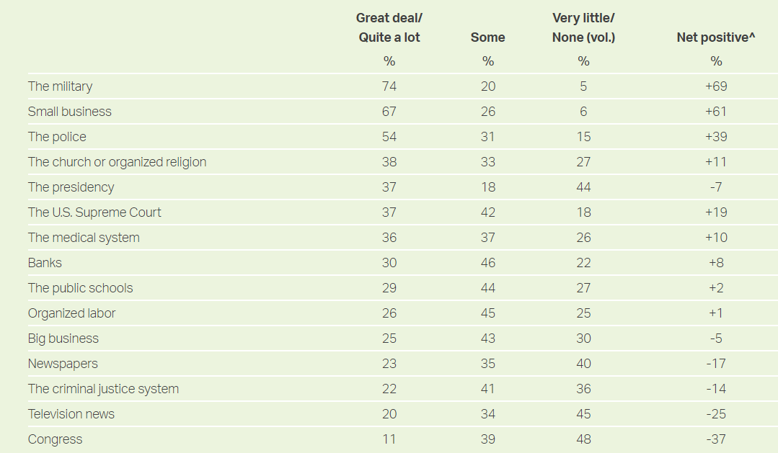
Policing Present

Slide 12
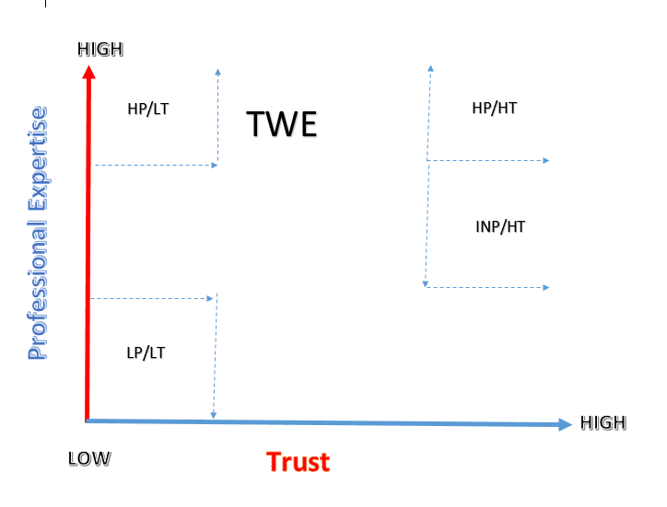
TRUST

Slide 13
MIND/BODY/SPIRIT
Being a good person and developing good people
Take care of Yourself
Take Care of Others
You as a Leader create CULTURE. Organizations succeed and fail based on CULTURE.

Slide 14
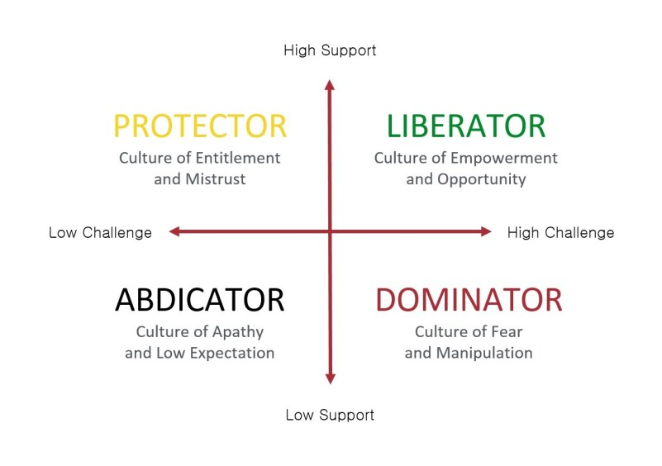
CULTURE

Slide 15
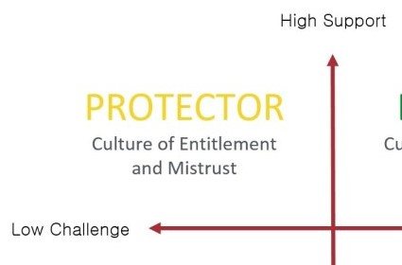
What we think is right??

Slide 16
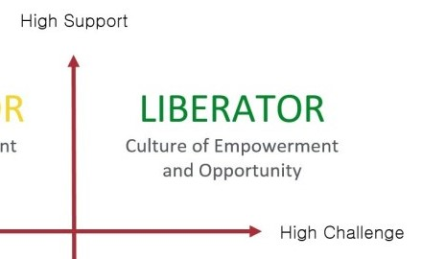
What is right !

Slide 17
Maturity
“Independent people who do not have the maturity to think and act “Interdependently” may be good individual producers, but they won’t be good leaders or team players.” Stephen R. Covey
Level 3
Level 2
Interdependent Member
Focus “US” all of “US” able to see the big picture. Mutually dependent upon each other
Independent Member
Major focus “We” the group/team focused. By themselves team apart from the whole
Level 1
Dependent Member
Major focus “I” Self Focused. Relying on others. What do I get out of the deal.

Slide 18
What is the SUPERIOR Choice?
“Many decisions have a short term gain but carry a long term loss, while others have short term loss but ensure long term gain. The more our VALUES are in alignment as a team, the more VALUE we create for everyone. UNITY is a powerful force in driving a positive CULTURE.
The Superior Choice
“Value Extraction or Value Input”
“E.R.”
“O.R.”
Ego and Rivalry
Ownership and Relationship
I
US ER
US
I OR

Slide 19
Leadership is about INFLUENCE

Slide 20
CULTURE
We DO NOT RISE to the occasion we FALL to OUR CULTURE
Espoused Values
Underlying Assumptions
Artifacts

Slide 21
DIRECTION
Where do we start with CULTURE and creating Value.
Mission
Vision
Values
The second paragraph of the United States Declaration of Independence starts as follows: "We hold these truths to be self-evident, that all men are created equal, that they are endowed by their Creator with certain unalienable Rights, that among these are Life, Liberty and the Pursuit of Happiness.
"I pledge allegiance to the Flag of the United States of America and to the Republic for which it stands, one nation, under God, indivisible, with liberty and justice for all.".

Slide 22
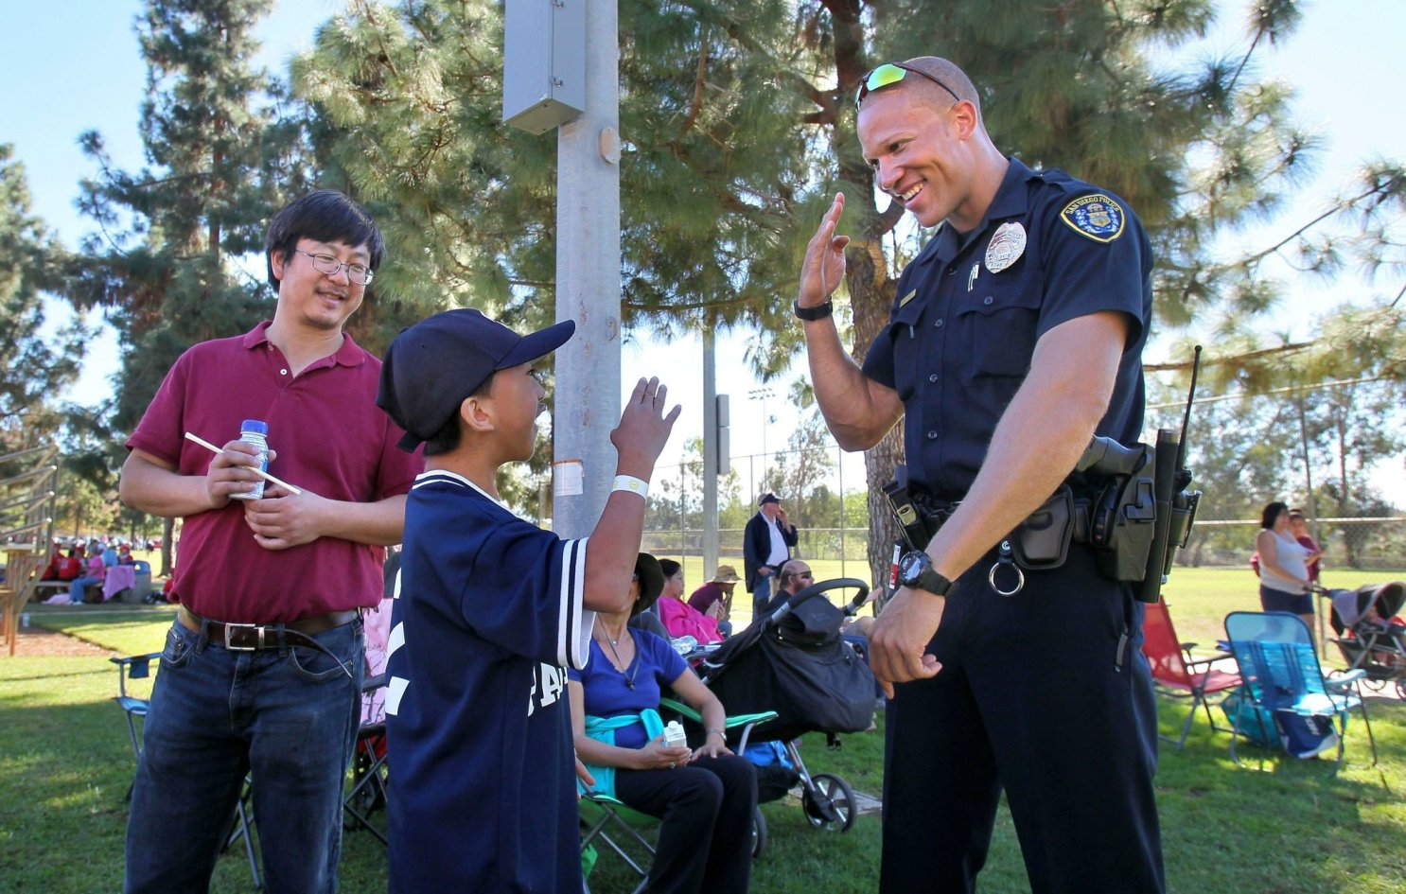
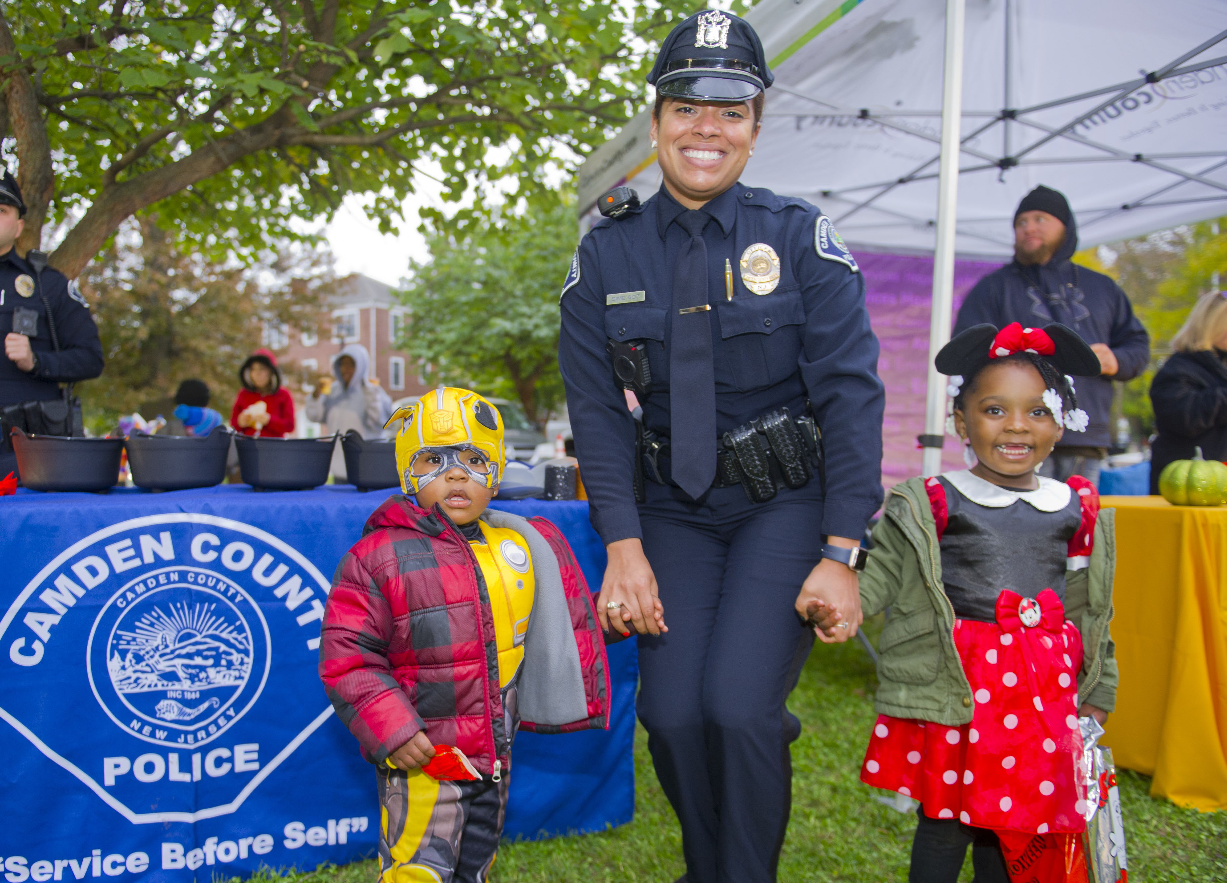
POLICING FUTURE

Slide 23
Law Enforcement Leaders

Slide 24
THANK YOU!
Todd Gibson
Phone
405-264-3907
Email
tgibson@cityofmoore.com

