Slide 1
Fair Labor Standards Act
OACP
Police Chief, Administrative and Command Staff Training
April 14, 2023

Slide 2
Fair Labor Standard Act
Establishes:
  Minimum Wage
  Overtime Pay
  Recordkeeping
  Child Labor Standards
Affects:
  Full-time
  Part-time
  Private Sector
  Federal, State and Local Governments

Slide 3
Wage and Hour Division
US Department of Labor
Administers and Enforces the FLSA
Special Rules Apply to State and Local Government Employment:
  Fire Protection
  Law Enforcement
  Volunteer Services
  Compensatory Time Off Instead of Cash Overtime Pay

Slide 4
Requirements:
Pay all nonexempt employees, for all hours worked, at least the Federal Minimum Wage of $7.25 per hour
Pay at least 1 ½ time the employee’s regular rate of pay for all hours worked over 40 in a workweek (different thresholds for fire and police)
Comply with the youth employment standards
Comply with the recordkeeping requirements

Slide 5
What are Hours Worked?
An employee must be paid for all hours worked.
This may include time spent engaged to wait, on-call, in training, or travelling, as well as sleep time (firefighters)
Work not requested but “suffered or permitted” is work time

Slide 6
Waiting Time
Hours Worked:
  Employee unable to use “waiting time” effectively for own purposes
  “Waiting Time” controlled by the employer
Not Hours Worked:
  Employee completely relieved of duty
  Break-time long enough for employee to use for own purposes

Slide 7
On-Call Time
Hours Worked:
  Employee must stay on employer premises
  Or, must be so close that time cannot be used effectively for own purposes
Not Hours Worked:
  Employee must provide contact information
  Employee can use time effectively for own purposes

Slide 8
Rest and Meal Periods
Short rest breaks (20 min or less) are compensable
Bona fide meal periods (typically 30 minutes or more) need not be paid as hours worked
Worker must be completely relieved of duty for meal period not to be compensable time.

Slide 9
Training Time
Time spent in meetings, lectures or training is considered hours worked and must be paid, unless:
Attendance outside regular work hours
Attendance is voluntary
Course, lecture, meeting not job-related, and
Employee does not perform any productive work

Slide 10
Travel Time
Ordinary home to work travel is not compensable work time
Travel between job sites during normal work day is work time and is compensable hours worked
Special rules apply to travel away from employee’s home

Slide 11
Overtime
1 ½ times the regular rate of pay for all hours worked over 40 in the workweek (or beyond the threshold if an alternate work period has been established)
Determined by the workweek (or work period for you law enforcement personnel)
Each workweek or work period stands alone
Workweek is 7 consecutive 24-hour periods (168 hours)

Slide 12
Who Is Exempt from Overtime Pay?
Employees who meet exemption requirements for Executive, Administrative, Professional or Outside Sales Occupations
Employees working in separate seasonal amusement or recreational establishments such as swimming pools, parks, etc.
Mass transit employees who spend some time engaged in charter activities
Employees who solely at their option occasionally or sporadically work on a part-time basis for the same public agency in a different capacity than the one in which they are normally employed
Employees who at their option with approval of the agency substitute for another during scheduled work hours in the same work capacity

Slide 13
Special Rules for Employees Engaged in Fire Protection and Law Enforcement Activities
  Includes Firefighters, Paramedics, Emergency Medical Technicians, Rescue Workers, Ambulance Personnel, or Hazardous Materials Workers who are:
    Trained in Fire Suppression
    Legal Authority and Responsibility to Engage in Fire Suppression
    Employed by a Fire Department of a Municipality, County, Fire District, or State
    Engaged in Prevention, Control and Extinguishment of Fires and Response to Emergency Situations where Life, Property, or the Environment is a Risk

Slide 14
Special Rules for Employees Engaged in Fire Protection and Law Enforcement Activities
Law Enforcement Personnel are:
  Empowered by State and Local Ordinance to Enforce Laws Designed to Maintain Peace and Order, Protect Life and Property, and to Prevent and Detect Crimes
  Have the Power to Arrest
  Have Undergone Training in Law Enforcement

Slide 15
Special Rules for Employees Engaged in Fire Protection and Law Enforcement Activities
Law Enforcement Personnel may:
  Perform some nonexempt work that is not performed as an incident to or in conjunction with their law enforcement activities
  However, a person who spends more than 20% of their workweek or applicable work period in nonexempt activities is not considered to be an employee engaged in law enforcement activities

Slide 16
Special Rules for Police:
K-9 Handlers: FLSA pay based upon all the time spent performing K-9 activities which are reasonably related to maintain the police dog for the job. PAY ATTENTION TO THE HOURS THEY SPEND CARING THE DOG!
Detectives/Investigators: Most are nonexempt and eligible for overtime. Watch those “off-the-clock” things like returning calls, answering emails, paperwork, meetings, etc. Those are compensable hours worked.
Command Staff: Many are exempt and not eligible for overtime. Must look at the salary and the duties to know for sure.

Slide 17
Executive Exemption
To qualify for the executive employee exemption, all of the following tests must be met:
  The employee must be compensated on a salary basis (as defined in the regulations) at a rate not less than $684* per week;
  The employee’s primary duty must be managing the enterprise, or managing a customarily recognized department or subdivision of the enterprise;
  The employee must customarily and regularly direct the work of at least two or more other full-time employees or their equivalent; and
  The employee must have the authority to hire or fire other employees, or the employee’s suggestions and recommendations as to the hiring, firing, advancement, promotion or any other change of status of other employees must be given particular weight.

Slide 18
Administrative Exemption
To qualify for the administrative employee exemption, all of the following tests must be met:
  The employee must be compensated on a salary or fee basis (as defined in the regulations) at a rate not less than $684* per week;
  The employee’s primary duty must be the performance of office or non-manual work directly related to the management or general business operations of the employer or the employer’s customers; and
  The employee’s primary duty includes the exercise of discretion and independent judgment with respect to matters of significance.

Slide 19
Who Might Be Exempt?
High-ranking police employees such as Police Chiefs, Deputy Chiefs, Captains, Lieutenants, and Corporals
Determined on a case-by-case basis based upon the duties for each
  Police Work – The more direct the work is performed, the less likely the employee will be considered exempt
  Discretion – Does the employee have the discretion to determine whether and where his/her assistance is needed? Are they dispatched directly?
  Managerial Tasks – Does the employee meet all the requirements to be exempt under the executive or administrative exemption and primarily perform managerial tasks?

Slide 20
Option to Establish a Work Period Ranging from 7 to 28 days
Overtime paid only after a specified number of hours in each work period
Does not include off-duty hours spent providing security for events under the special detail exemption

Slide 21
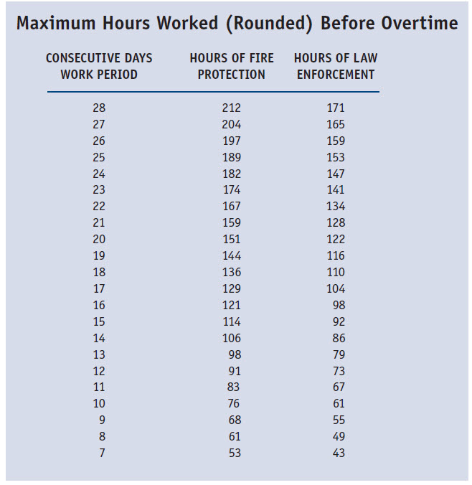

Slide 22
Special Exception:
Agencies employing less than 5 employees in fire protection or law enforcement may be exempt from overtime.
It’s a policy call!

Slide 23
Recordkeeping
(1) personal information, including employee’s name, home address, occupation, gender, and birth date if under 19 years of age
(2) hour and day when workweek begins
(3) total hours worked each workday and each workweek
(4) total daily or weekly straight-time earnings
(5) regular hourly pay rate for any week when overtime is worked
(6) total overtime pay for the workweek
(7) deductions from or additions to wages
(8) total wages paid each pay period
(9) date of payment and pay period covered

Slide 24
Workplace Posting
Covered employers must post a notice
explaining the FLSA, as prescribed by the
Wage and Hour Division, in a conspicuous place
such as a lunch room or employee lounge area.
Download the poster electronically at :
www.dol.gov

Slide 25
Enforcement
(1) Investigation by the Wage and Hour Division
(2) Legal Remedies through Administrative Procedures, Litigation, and/or Criminal Prosecution
i) Back Wages
ii) Liquidated damages (Double Damages)
iii) Two-year statute of limitations (Three years for willful violations)

Slide 26
Enforcement Limits
FLSA does NOT require:
  Vacation, holiday, severance, sick pay
  Meal or rest periods, holidays off, vacations
  Premium pay for weekend or holiday work
  Discharge notice, reason for discharge
  Limit on number of hours or days employees
  16 years or older may work
  Pay raises, fringe benefits

Slide 27
Retaliation Prohibited
Employee who have filed complaints or provided information cannot be discriminated against or discharged on account of such activity.
If adverse action is taken against an employee for engaging in protected activity, the affected employee or the Secretary of Labor may file suit for relief, including reinstatement to his/her job, payment of lost wages, and damages.

Slide 28
QUESTIONS?
OMAG Legal Team:
Matt Love, General Counsel
Monica Coleman, Associate General Counsel
Jeff Bryant, Associate General Counsel
Ambre Gooch, Associate General Counsel

