Slide 1
HEALING BEGINS IN
COURAGEOUS CONVERSATIONS

Slide 2
Leading Through Tough Times
Peer Support- Warrior Wellness

Slide 3
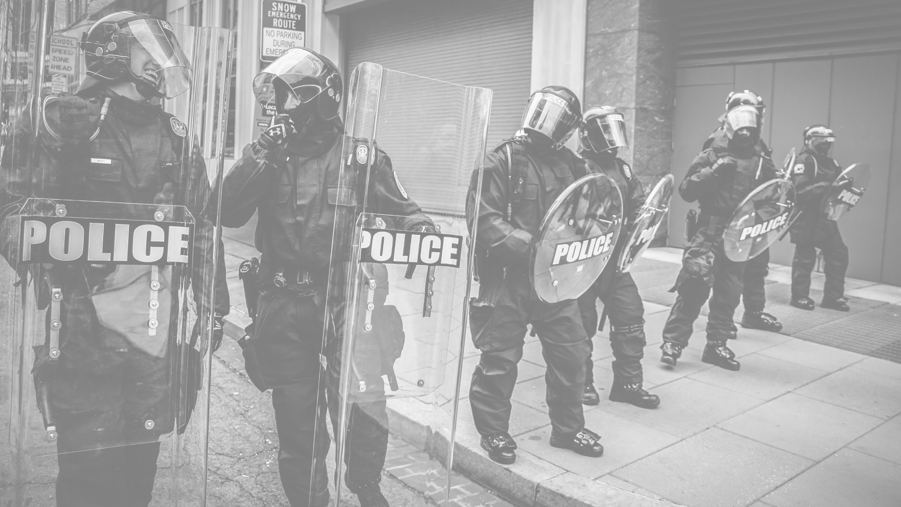
Building Trust
“ People of genius are admired, people of wealth are envied, people of power are feared: but only those of character are trusted” - ArthurFriedman

Slide 4
WHO DO YOU TRUST?
Who do you trust most?
Why do you trust them?
Who do you believe trust you?
Why do they trust you?

Slide 5
WHAT IS TRUST?
“Trust is the intentional decision to welcome risk, believing in the dependability, motives, and aims of others.”
-Dr, Virginia Smith
What are some ways you demonstrate to others that you can be trusted?
Why does trust involve being vulnerable?

Slide 6
Challenges/Solutions
LACK OF TRUST
“The toughest thing about the power of trust is that it’s difficult to build and very easy to destroy.” - Thomas J. Watson
UNRELIABLE
RESPONSIBILITY
WITHHOLDS KEY
INFORMATION
SINCERITY
EXAGGERATES OR SPINS THE TRUTH
HONESTY

Slide 7
RESPONSIBILITY
Knowing and doing what is expected of me.
How do people learn what is expected of them in your department?
How can a person demonstrate responsibility in your department?

Slide 8
RESPONSIBILITY
Knowing and doing what is expected of me.
Clearly communicate expectations
Ask for clarification if you do not understand what is expected of you
Be careful to promise only that which you can deliver
Communicate with others if you discover you cannot meet expectations.
Ask for help when needed.
Take responsibility for your mistakes

Slide 9
SINCERITY
Doing what is right with transparent motives.
What does it mean to be transparent?
How can a person demonstrate transparency in your department?

Slide 10
SINCERITY
Doing what is right with transparent motives.
Check your motives
Be sure you share all important information
Mean what you say and say what you mean
Be consistent.
Be open and honest

Slide 11
HONESTY
Being truthful in what you say and do.
Why is a reputation for not exaggerating important to developing trust?
How can a person demonstrate honesty in your department?

Slide 12
HONESTY
Being truthful in what I say and do.
Say what you mean, without being mean
Watch for “spin”
Resist the temptation of exaggerate or embellish
Make sure your actions back up your words
Communicate openly and effectively
Stand up against dishonesty

Slide 13
Supporting the Health and Wellness of your Organization

Slide 14
DEFINITIONS
Peer Support
External Support
Critical Incident
Defusing
Debriefing
Post Traumatic Stress Injury
Mental Health Professional

Slide 15
CRITICAL INCIDENT
“Any event which has the potential to overwhelm one’s
usual coping mechanisms resulting in psychological distress
and an impairment of normal adaptive functioning”

Slide 16
“The Terrible Ten”
•Suicide of Friend or Colleague
•Line of Duty Death
•Line of Duty Injury
•Disaster / Multi-Casualty Incident
•Shootings / Explosions or Events with Extreme Threat to Participants
•Significant Events involving Children
•Prolonged Incidents
•Events involving Persons known to the operations personnel
•Excessive Media
•Event capable of causing considerable Emotional Distress

Slide 17
SUDDEN CHANGES IN BEHAVIOR
Increased “sick days”
Poor work performance
Avoidance of work altogether, certain job requirements,
or types of calls
Sudden talk of quitting
Avoidance of home
Requesting additional shifts or excessive amounts of overtime
Decreased social interactions
Increased anger and irritability
Increased alcohol use
DUI or other offenses

Slide 18
PEER SUPPORT
Usually a Peer Support Responder (PSR):
A specially trained individual who provides approved
intervention services to agency personnel and their
immediate families. PSR’s sign an agreement that contains a
strong confidentiality clause.

Slide 19
WHAT PSR’S ARE NOT…
PSR’S are not therapist nor counselors and do not deliver
therapy.
PSR’s are officers 1st and peer supporters 2nd… any
conflicts of roles are resolved in that context.
PSR’s are not legal consultants and shall not act in that
capacity.
Life issues, officer 1st

Slide 20
PEER SUPPORT RESPONSE GOALS
Educate personnel in stress management and
reduction … prior to the event
Identify, decrease and mediate negative responses
that may occur in personnel … during the event
Refer for treatment and further assessment, if
necessary
Follow-up … after the event

Slide 21
PEER SUPPORT RESPONSE GOALS
Help anticipate and address potential difficulties.
Provide … employees … the opportunity to
receive emotional and tangible peer support
through times of personal or professional crises

Slide 22
CRITICAL INCIDENT STRESS
MANAGEMENT (CISM)
Programs and strategies designed to reduce the effects of
stress in emergency services personnel and to assist them in
recovering from significant work stress.
Three main strategies (ISP):
Demobilization
Defusing
Debriefing

Slide 23
DEFUSING
A peer driven group process integrating crisis intervention
strategies
A shortened version of a debriefing that takes place
immediately or relatively soon after a critical incident
1-4 hours but not more than 12 hours after the event*
If defusing not possible, CISD should be considered
May be mandatory

Slide 24
DEBRIEFING (CISD)
A structured group discussion of a critical incident led by a MHP or
Peer.
Integrates crisis intervention strategies with educational techniques for
coping with stress
May be mandatory
Normally led by MHP and supported by Peers
Typically held 24-72 hours post-event
Goal is to mitigate or resolve psychological stress associated with a
critical incident or traumatic event
Intention is to accelerate the recovery of those affected

Slide 25
MENTAL HEALTH
PROFESSIONAL
A licensed social or mental health worker, counselor,
psychotherapist, psychologist or psychiatrist.
MUST BE CULTURALLY COMPETENT

Slide 26
Oklahoma SB 848 For First Responders:
•SB 848 directs ODMHSAS to contract with Public and Private entities located in Oklahoma to provide Peer Support Crisis Intervention, Counseling and Wellness for First Responder communities impacted by Trauma, Stress, Anxiety, Addictions, Death and Suicide.
•
•Qualified Crisis Intervention Training entities are required to provide Peer Support Teams trained in Crisis Intervention and Wellness Strategies and must be derived from the International Critical Incident Stress Foundation (ICISF) and must employ the Critical Incident Stress Management (CISM) crisis intervention process.

Slide 27
CONFIDENTIALITY EXCEPTIONS
Criminal activity
Using service as a means to relieve or diminish violations of oath of
office
Employee presents a clear and present danger to self or others
Written consent from employee

Slide 28
CONFIDENTIALITY
All information and correspondence pertaining to employee mental health
issues shall remain confidential. The information may be discussed only among those persons directly involved in the situation and/or those with a lawful need to know…

Slide 29
BENEFIT OF PEER SUPPORT
Helps leadership address stress management, mental health
concerns, suicide prevention and overall officer safety and
wellness.
A 2018 survey of police officers…
90% of respondents who had used peer support reported that it was
helpful to very helpful,
80% reported they would seek support again if needed, and nearly 90%
stated they would recommend peer support to a colleague.
More than half of the officers who connected with peer support indicated
that these services helped them perform their job better or improved
their personal life.

Slide 30
LEADER’S RESPONSE TO PERSONNEL
IN CRISIS
THE BIGGEST CHALLENGE WE FACE IS “LEADING
OUR OFFICERS”, EACH OFFICER IS UNIQUE IN THAT THEY HAVE
THEIR OWN MOTIVATIONS, WANTS, NEEDS AND DESIRES OUT
OF “THE JOB”. EACH OFFICER COMES FROM DIFFERENT
SOCIO/ECONOMIC, ETHNIC AND RELIGIOUS BACKGROUNDS. IT
IS OUR JOB TO FIND WHAT INSPIRES THEM TO NOT ONLY MEET
DEPARTMENTAL GOALS AND OBJECTIVES BUT TO EXCEED
THEM (TRANSFORMATIONAL LEADERSHIP)

Slide 31
RECOGNIZING SIGNS OF STRESS
IN YOURSELF OR YOUR OFFICERS
“Today/tonight was really rough. How are you holding up?”
“I’ve noticed you seem upset; do you want to talk about it?”
“Do you need anything?”
“How can I help?”
Encourage officers to seek assistance
Consider sharing when you sought help

Slide 32
PCIS
Post Critical Incident Seminar (PCIS)
•Originally created by the FBI for law enforcement officers, the PCIS is a 3-day workshop for ALL First Responders who have been significantly impacted by a critical incident or several critical incidents.
•There is NO FEE for the PCIS. Your travel expenses to/from the PCIS location will be your only costs.
•Staffed by Mental Health Professionals with a heavy case load of 1st Responders, Experienced Peer Support, and CISM trained Chaplains.

Slide 33
WARRIOR'S REST FOUNDATION
RESTORING THE WARRIOR WITHIN

Slide 34
•
BRETT KEY CEO
CELL (405) 509-4036
Brett@warriorsrestfoundation.org
GARY BERRYHILL Director of Operations Oklahoma Peer Network
CELL (405) 514-5334
Gary@warriorsrestfoundation.org
Dr. KATHY THOMAS Clinical Director
CELL (405) 612-2335
Kathy@warriorsrestfoundation.org
John Blumenthal “Blu” Chief Operations Officer
CELL (405) 521-7903
John@warriorsrestfoundation.org

